Slide 1
Make Your R Code purr with purrr
Ghement Statistical Consulting Company Ltd.
R Ladies Baltimore May 2022
Dr. Isabella R. Ghement
Phone: 604-767-1250
E-mail: isabella@ghement.ca
Web: www.ghement.ca
Twitter: @IsabellaGhement
Notes:
https://www.tidyverse.org/blog/2017/12/workflow-vs-script/
Solomon Kurtz GLMM Notes: https://osf.io/3g8vf/

Slide 2

Outline
map(.x, .f, ...)
| |
vector function
or list

Slide 3

What is an R Function?
Apply
Recipe
Input Ingredient(s)
Output
break egg in a pan
fry egg for 5 minutes

Slide 4
Syntax of a Named R Function
make_fried_egg <- function(egg){
break egg in pan
fry egg for 5 minutes
return(fried egg)
}
function name
function
keyword
function ingredient
function instructions
function
result
curly
brackets

Slide 5
Vector
A vector is like a cardboard of eggs which has a single column of eggs.
All the eggs must be of the same “type” (e.g., chicken eggs).

Slide 6
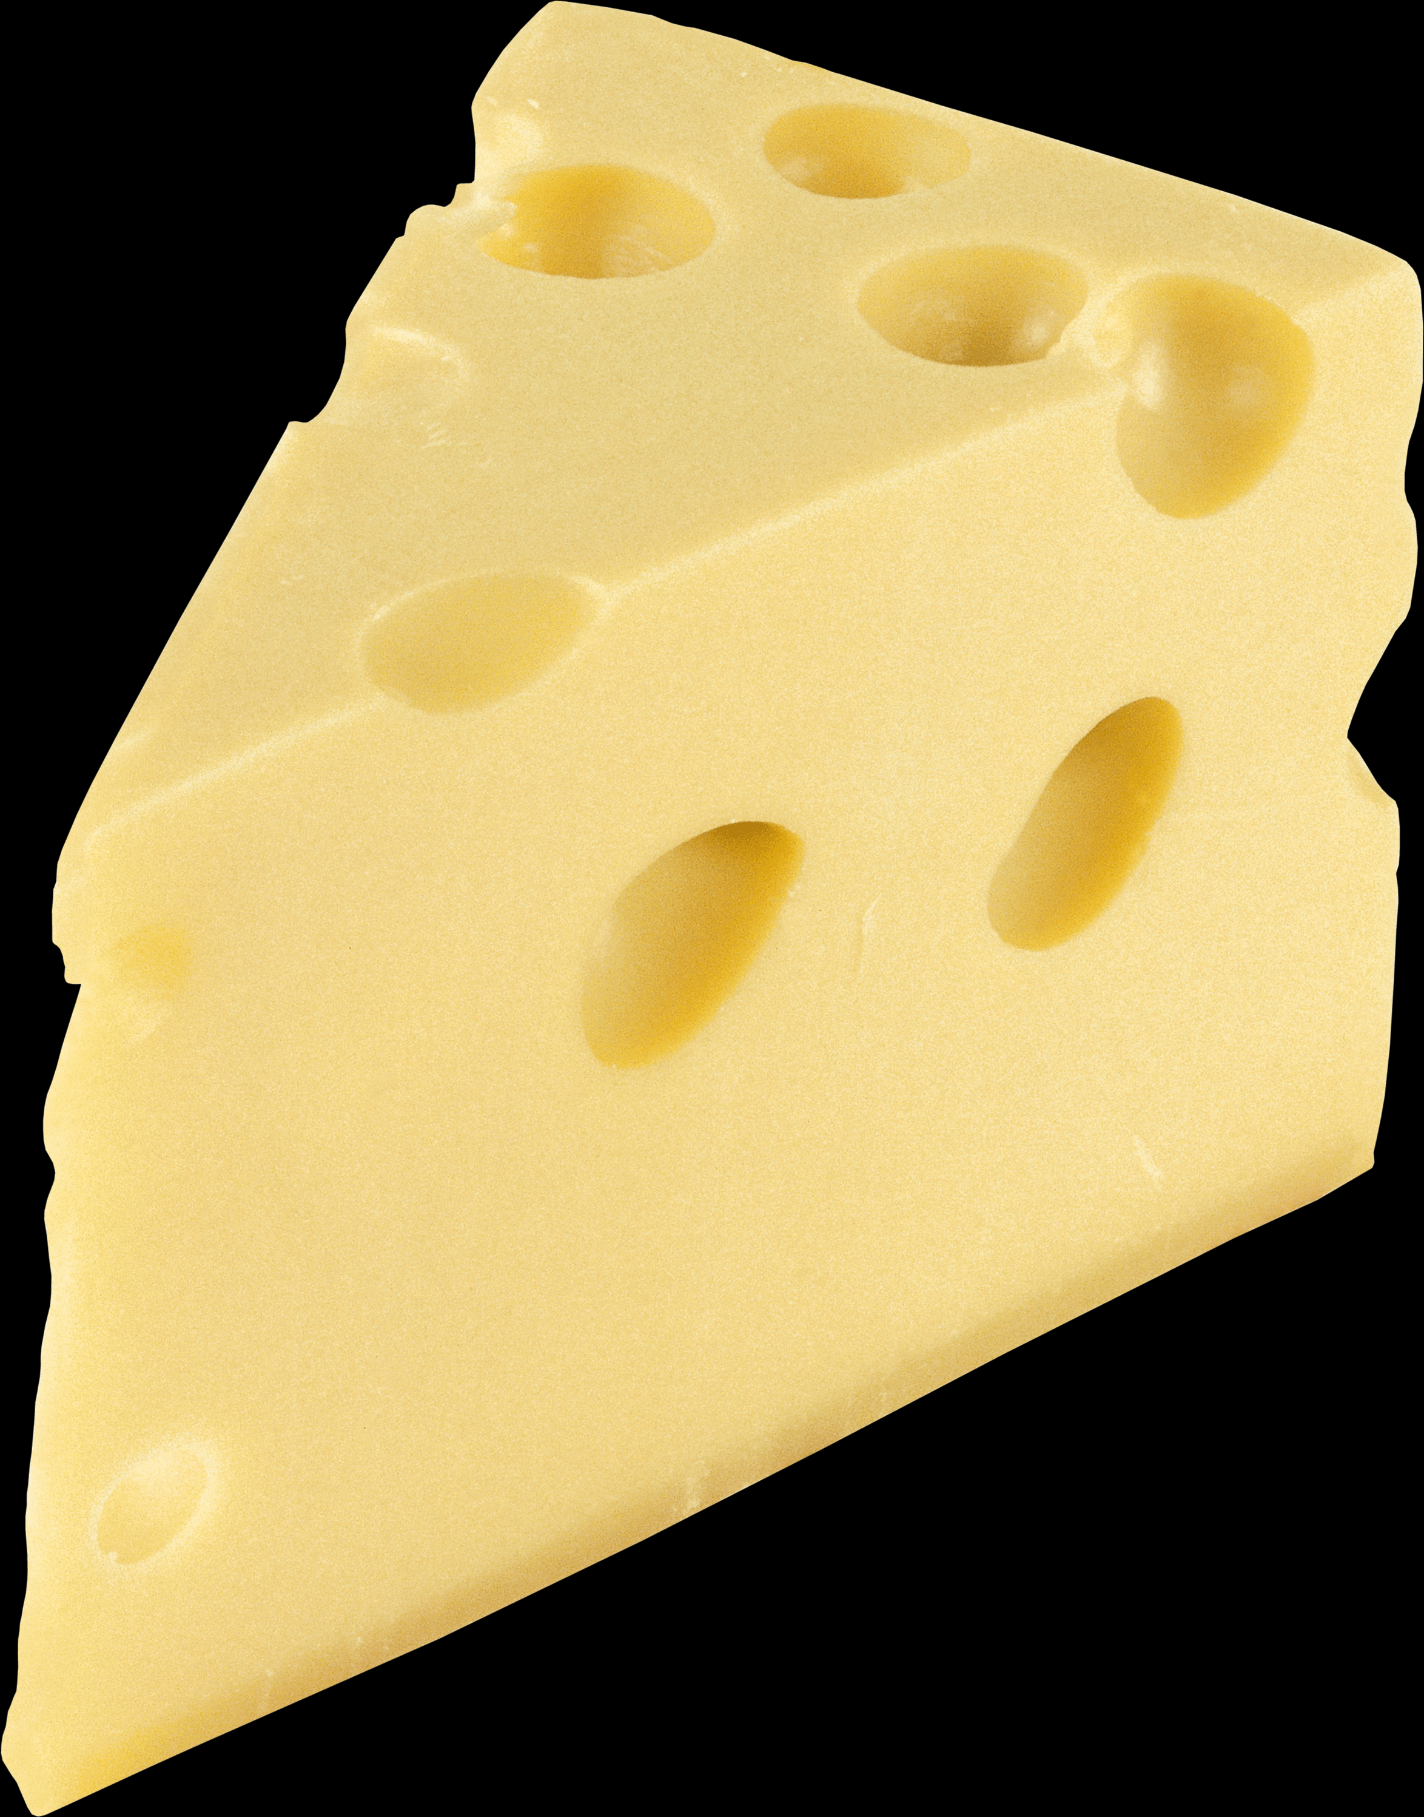
List
A list is a hodge-podge of different entities.
It is useful for storing input ingredients or
output results for an R function.

Slide 7
purrr
The purrr package allows us to:
Apply named or unnamed functions to vectors or lists;
Save the results in a variety of convenient formats.
To install the package:
install.packages("purrr")

Slide 8
When do we need purrr?
What if we need to make multiple fried eggs simultaneously?

Slide 9
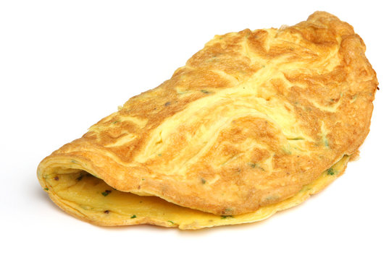
When do we need purrr?
What if we need to combine the eggs with cheese and make multiple
cheese omelettes simultaneously?

Slide 10
When do we need purrr?
What if we need to combine all eggs and make a single giant omellete?

Slide 11
map
The map() function is the workhorse of the purrr package.
We can use map() to apply the same operation (with the operation encapsulated into a named/unnamed R function) to our input ingredient(s).

Slide 12
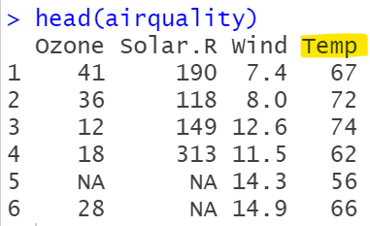
map
Example 1:
Use map() to apply the same operation to each element of a vector via a named R function.
FtoC <- function(F) {
C <- (F - 32)*5/9
C
}
Temp column
of airquality
dataset
(expressed
in degrees Fahrenheit)
TempC column
of airquality
dataset
(converted to
Degrees Celsius)

Slide 13
map
map(.x, .f, ...)
| |
vector function
or list
library(magrittr)
library(dplyr)
library(purrr)
# test that we can apply map to a single column
map(.x = airquality$Temp, .f = FtoC)
# save the result of Temp column conversion as a new
# column in airquality dataset, named TempC
airquality <- airquality %>%
mutate(TempC = map(Temp, FtoC),
TempC = unlist(TempC))
str(airquality)

Slide 14
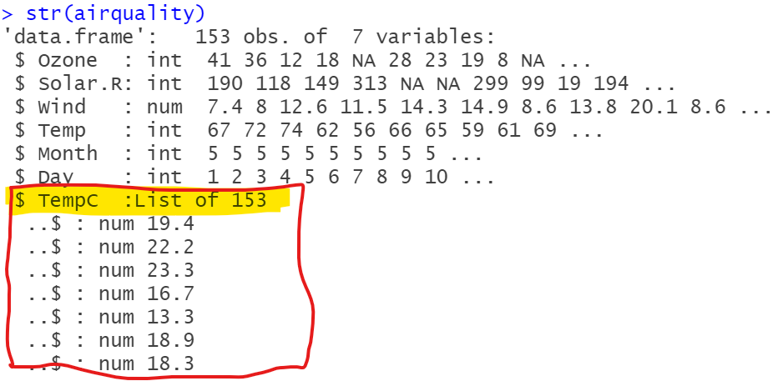
map
map() will return results in the form of a list, which can be a pain.
To unlist the results, we can use the unlist() function right after using the map() function. Better still, we can use a specialized version of map() named map_dbl().

Slide 15
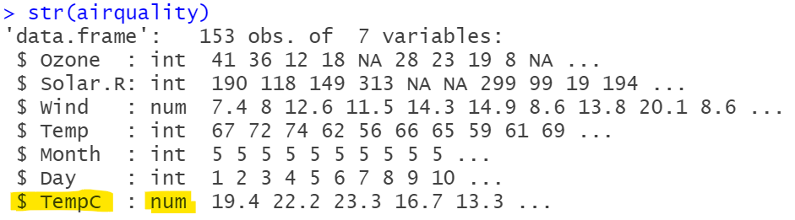
map_dbl as a specialized version of map
# map_dbl() is the equivalent of using map() + unlist(); it will
# return a vector instead of a list
airquality <- airquality %>%
mutate(TempC = map_dbl(Temp, FtoC))
str(airquality)

Slide 16
map
Example 2:
Use map() to apply the same operation to each relevant column of a data frame via a named R function.
# function for computing the mean
# of a numeric column after removing
# missing data values
mymean <- function(x){
mean(x, na.rm = TRUE)
}

Slide 17
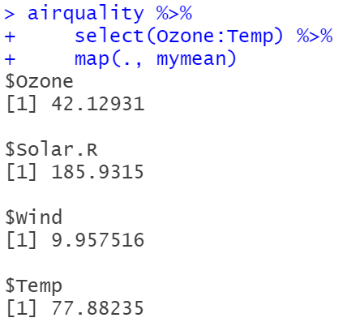
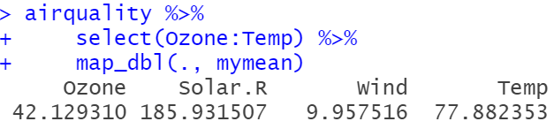



map versus map_dbl
airquality %>%
select(Ozone:Temp) %>%
map(., mymean) %>% unlist()
airquality %>%
select(Ozone:Temp) %>%
map_dbl(., mymean)
map() returns a list.
map_dbl() returns a vector.

Slide 18
What other flavours of map() are available?
?map
“map_lgl(), map_int(), map_dbl() and map_chr() return an atomic vector of the indicated type (or die trying).”

Slide 19
map2
map2(.x, .y, .f, ...)
| / |
vector function
or list

Slide 20
map2 + plotting
histogram <- function(data, var){
library(ggplot2); library(magrittr); library(rlang)
theme_set(theme_bw())
plot <- ggplot(data, aes(x = .data[[var]])) +
geom_histogram(colour="white", fill = "lightblue",
binwidth = function(x) 2 * IQR(x) /
(length(x)^(1/3)))
return(plot)
}

Slide 21
map2 + plotting
airquality_num <- select(airquality, Ozone:Temp)
airquality_num
histograms <-
map2(.x = list(airquality_num), # data
.y = names(airquality_num), # var
.f = histogram)
histograms

Slide 22
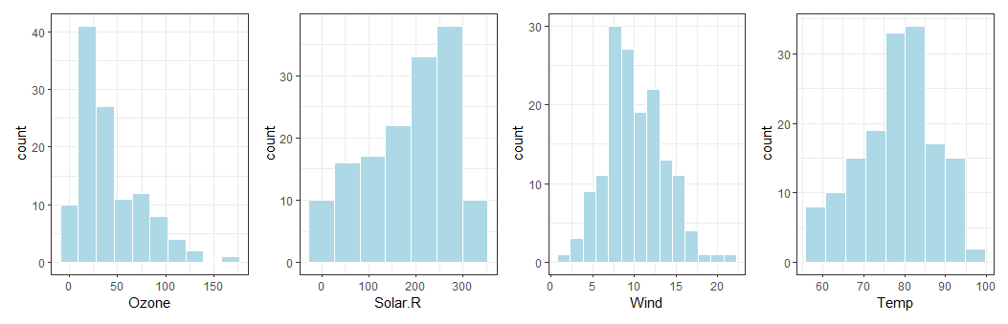
map2 + plotting
library(patchwork)
wrap_plots(histograms) +
plot_layout(nrow = length(histograms))

Slide 23
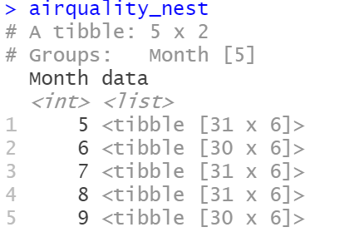
map + nested data frames
What if we need to compute the mean of the Ozone variable for each Month present in the data?
library(magrittr)
library(dplyr)
library(purrr)
library(tidyr)
airquality_nest <- airquality %>%
group_by(Month) %>%
nest()
airquality_nest
airquality data for each Month are nested within the rows of airquality_month, under the list column named data
airquality_nest$data[[1]]
Notes:
Simplifying tidy workflow with list of tibbles and purrr - tidyverse - RStudio Community

Slide 24
map + nested data frames
What if we need to compute
the mean
of the Ozone variable
for each Month present in the data?

Slide 25
map + nested data frames
# define function to compute mean of Ozone variable
compute_mean_Ozone <- function(data) {
data %>%
dplyr::select(Ozone) %>%
dplyr::summarize(MeanOzone = mean(Ozone, na.rm = TRUE)) %>%
dplyr::pull(MeanOzone)
}
# apply defined function to each element of the data column of
# airquality_nest
airquality_nest %>%
mutate(MeanOzone = map_dbl(.x = data, .f = compute_mean_Ozone))
Notes:
https://firas.moosvi.com/courses/2021_WT2/data542/class/R/07-mapping-and-nested-data-frames.html

Slide 26
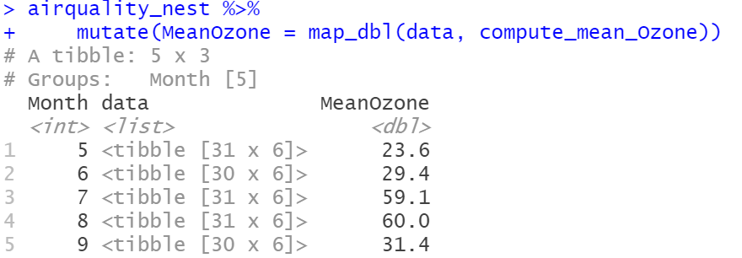
map + nested data frames

Slide 27
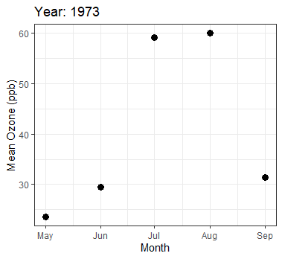
map + nested data frames
Some plotting…
library(ggplot2)
library(lubridate)
theme_set(theme_bw())
airquality_nest %>%
mutate(MeanOzone = map_dbl(data, compute_mean_Ozone)) %>%
mutate(Date = make_date(year = 1973, month = Month, day = 1)) %>%
ggplot() +
aes(x = Date, y = MeanOzone) +
geom_point(size = 3) +
scale_x_date(date_labels = "%b") +
ylab("Mean Ozone (ppb)") + xlab("Month") + ggtitle("Year: 1973")

Slide 28
map + nested data frames
What if we need to compute the
mean AND median
of the Ozone variable
for each Month present in the data?

Slide 29
map + nested data frames
# define function to compute mean AND median of Ozone variable
compute_mean_median_Ozone <- function(data) {
data %>%
select(Ozone) %>%
summarize(MeanOzone = mean(Ozone, na.rm = TRUE),
MedianOzone = median(Ozone, na.rm = TRUE))
}
# apply defined function to each element of the data column of
# airquality_nest
airquality_nest_Ozone_descriptives <-
airquality_nest %>%
mutate(OzoneDescriptives =
map(data, compute_mean_median_Ozone))

Slide 30
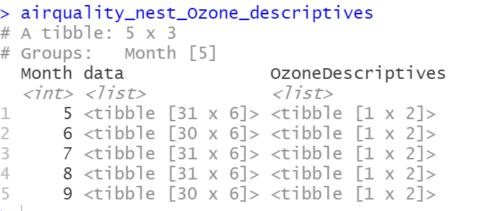
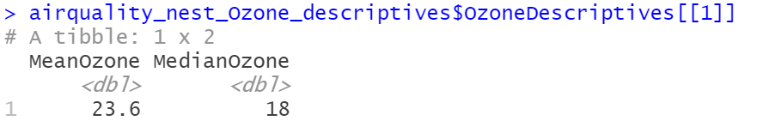
map + nested data frames
airquality_nest_Ozone_descriptives
airquality_nest_Ozone_descriptives$OzoneDescriptives[[1]]

Slide 31
map + nested data frames
What if we need to compute the mean
of the Ozone through Temp variables
for each Month present in the data?

Slide 32
map_df + nested data frames
# define function to compute mean of Ozone through Temp
# variables
compute_mean_Ozone_through_Temp <- function(data) {
data %>%
summarize_at(vars(Ozone:Temp), mean, na.rm = TRUE)
}
# apply defined function to each element of the data column of
# airquality_nest
airquality_nest_Ozone_though_Temp_descriptives <-
airquality_nest %>%
mutate(Mean = map_df(data, compute_mean_Ozone_through_Temp))

Slide 33
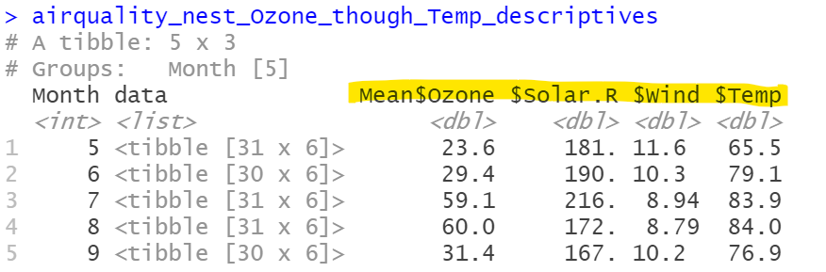
map + nested data frames
airquality_nest_Ozone_though_Temp_descriptives

Slide 34
map + nested data frames
What if we need to compute the
mean AND median
of the Ozone through Temp variables
for each Month present in the data?

Slide 35
map_df + nested data frames
# define function to compute mean AND median of Ozone
# through Temp variables
compute_mean_median_Ozone_through_Temp <- function(data) {
data %>%
summarize_at(vars(Ozone:Temp),
list(mean = mean, median = median),
na.rm = TRUE)
}
# apply defined function to each element of the data column of
# airquality_nest
airquality_nest_Ozone_though_Temp_descriptives <-
airquality_nest %>%
mutate(Descriptives =
map_df(data, compute_mean_median_Ozone_through_Temp))
Notes:
%>% unnest(Mean)

Slide 36
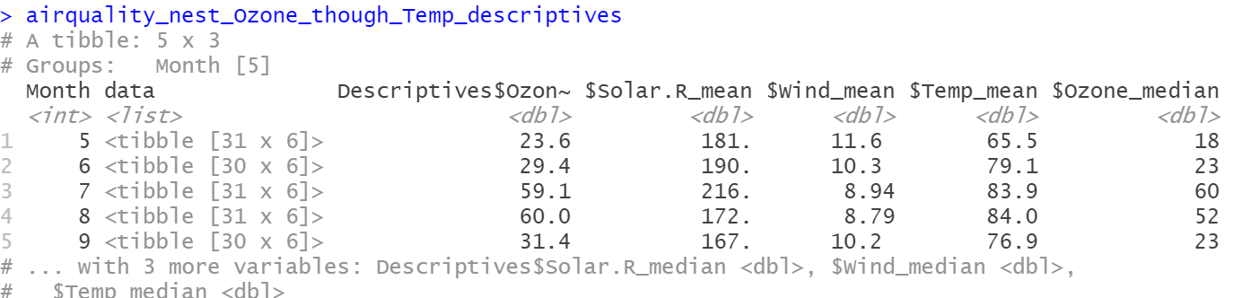
map_df + nested data frames
airquality_nest_Ozone_though_Temp_descriptives

Slide 37
Can we fit models to nested data frames?
# define function to fit a linear model
fit_lm_model <- function(data) {
data %>%
lm(Ozone ~ Temp, na.action = na.exclude, data = .)
}
# apply defined function to each element of the data
# column of airquality_nest
airquality_nest_lm <-
airquality_nest %>%
mutate(model = map(data, fit_lm_model))

Slide 38
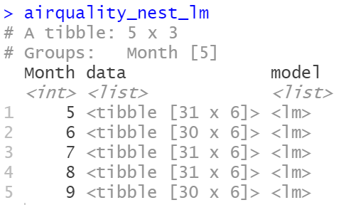
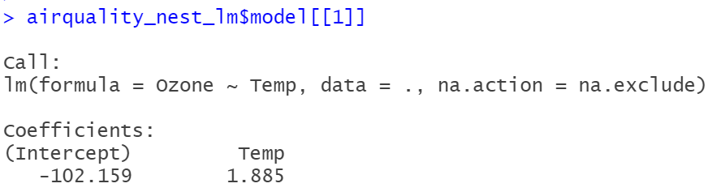
Can we fit models to nested data frames?
Once we have the lm models for each month, we can do further processing of each model (e.g., extract the model coefficients or the R-squared values and store them in the nested data frame).
airquality_nest_lm$model[[1]]

Slide 39

Can we further process models stored in a nested data frames?
library(broom)
airquality_nest_lm <-
airquality_nest_lm %>%
mutate(coeff = map(model, ~ tidy(.x)))
model
coeff
Month 5
Month 6
Month 7
Month 8
Month 9

Slide 40
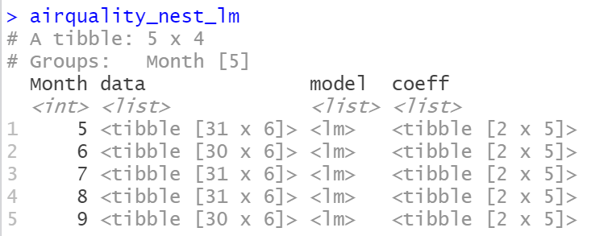
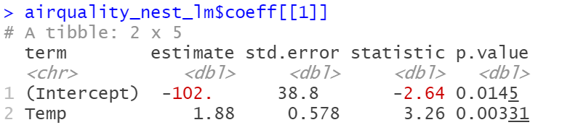
Can we further process models stored in a nested data frames?
airquality_nest_lm
airquality_nest_lm$coeff[[1]]

Slide 41
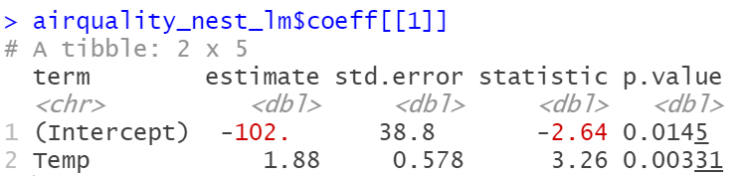
Can we further process models stored in a nested data frames?

Slide 42
Can we further process models stored in a nested data frames?
library(performance)
airquality_nest_lm <-
airquality_nest_lm %>%
mutate(rsquared = map(model, ~ r2(.x)))
airquality_nest_lm$rsquared

Slide 43
map_dfr: Read multiple datasets
map_dfr() is useful for reading multiple datasets into R and storing them in a combined dataset.
airquality_5 <- airquality %>% filter(Month == 5)
airquality_6 <- airquality %>% filter(Month == 6)
airquality_7 <- airquality %>% filter(Month == 7)
airquality_8 <- airquality %>% filter(Month == 8)
airquality_9 <- airquality %>% filter(Month == 9)
Notes:
setwd("I:\\purrr\\Talk")

Slide 44
map_dfr: Read multiple datasets
rio::export(airquality_5, "Data\\airquality_5.csv")
rio::export(airquality_6, "Data\\airquality_6.csv")
rio::export(airquality_7, "Data\\airquality_7.csv")
rio::export(airquality_8, "Data\\airquality_8.csv")
rio::export(airquality_9, "Data\\airquality_9.csv")

Slide 45
map_dfr: Read multiple datasets
library(purrr)
library(magrittr)
library(stringr)
library(readr)
datasets <- str_glue("Data/airquality_{5:9}.csv")
datasets
combined_dataset <- datasets %>%
map_dfr(read_csv)
combined_dataset

Slide 46
walk: Export multiple datasets
library(stringr)
library(readr)
dataframes <- list(airquality_5 = airquality_5,
airquality_6 = airquality_6)
dataframes %>%
names(.) %>%
walk(~ write_csv(dataframes[[.]],
paste0("Data/", ., ".csv")))
Works with map() too instead of walk().
Notes:
https://stackoverflow.com/questions/47528368/write-multiple-data-frames-to-csv-file-using-purrrmap

Slide 47
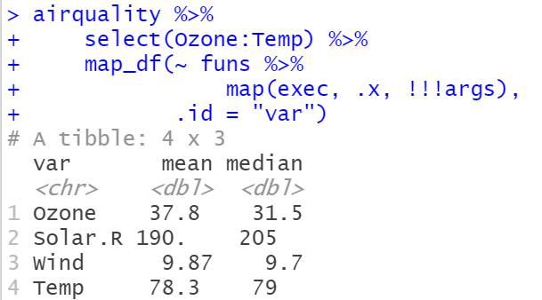
Can we apply multiple functions simultaneously?
invoke_map() is deprecated.
funs <- c(mean = mean, median = median)
# trim argument non-matching and ignored for median
args <- list(na.rm = TRUE, trim = .1)
airquality %>%
select(Ozone:Temp) %>%
map_df(~ funs %>%
map(exec, .x, !!!args),
.id = "var")
Notes:
https://stackoverflow.com/questions/47415072/pass-multiple-functions-to-purrrmap

Slide 48
Resources
Functional Programming (stanford.edu)
https://dcl-prog.stanford.edu/
Google: R + purrr
Talk Slides:
https://github.com/rladies/meetup-presentations_baltimore

